Slide 1
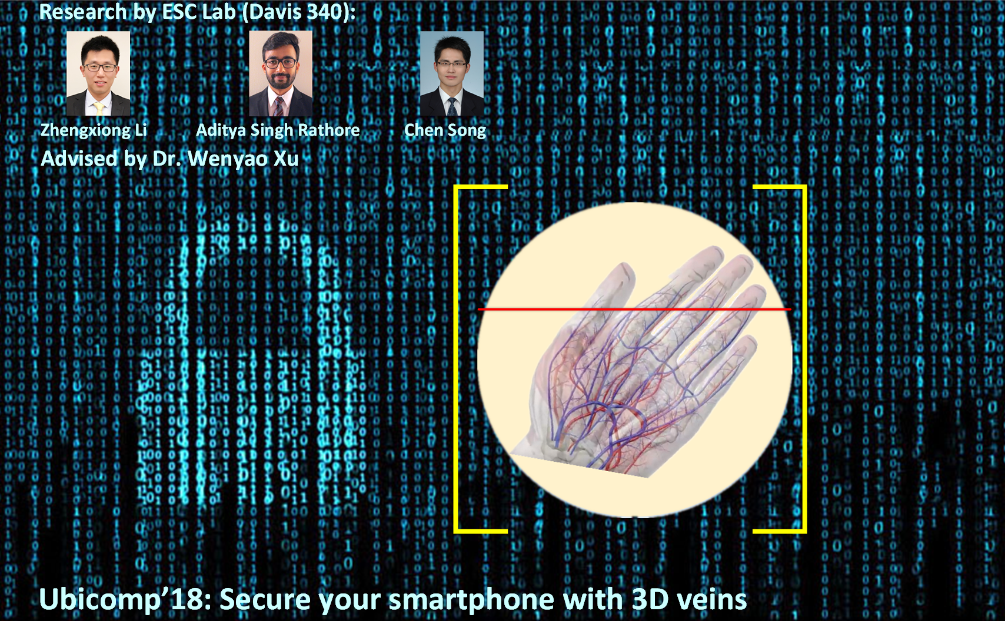
PAvessel: Practical 3D Vessel Structure Sensing through Photoacoustic Effects with Its Applications in Palm Biometrics
UbiComp 2018

Slide 2
PAvessel: Practical 3D Vessel Structure Sensing through Photoacoustic Effects with Its Applications in Palm Biometrics
Ubicomp 2018
Zhengxiong Li, Yuehang Wang, Aditya Singh Rathore, Chen Song, Nikhila Nyayapathi, Tri Vu, Jun Xia and Wenyao Xu

Slide 3
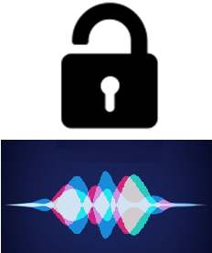



Biometric authentication

Slide 4

Biometric authentication
Can they really protect us?

Slide 5
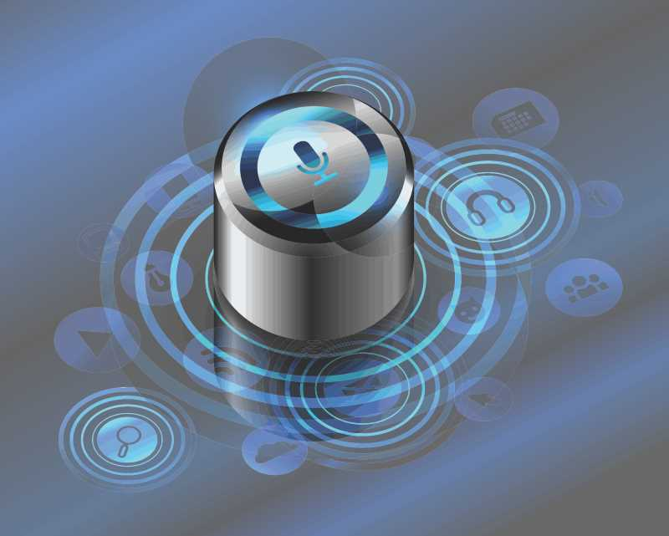
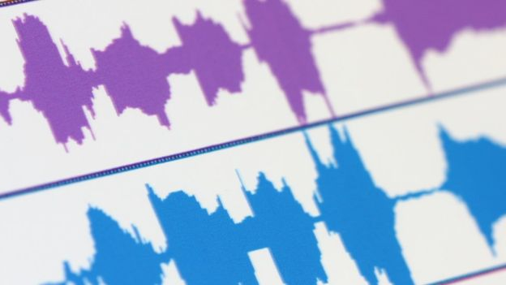
Biometric authentication
From: https://threatpost.com/black-hat-2018-voice-authentication-is-broken-researchers-say/134926/

Slide 6
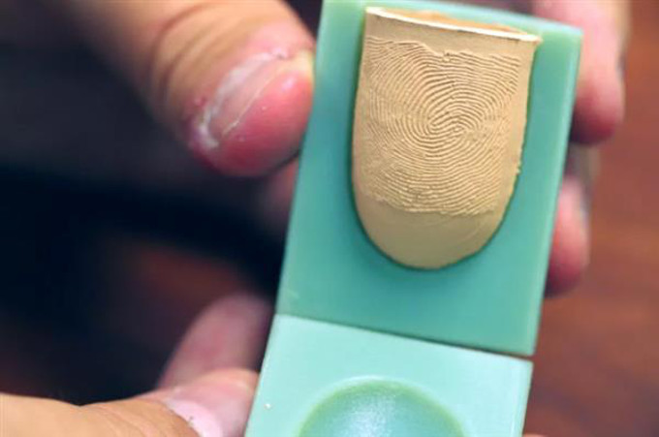
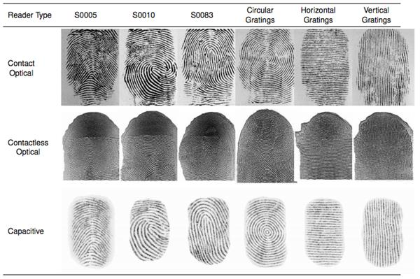
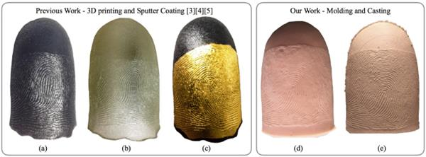
Biometric authentication
From: https://www.3dnatives.com/en/3d-printed-fingerprints-260920174/

Slide 7
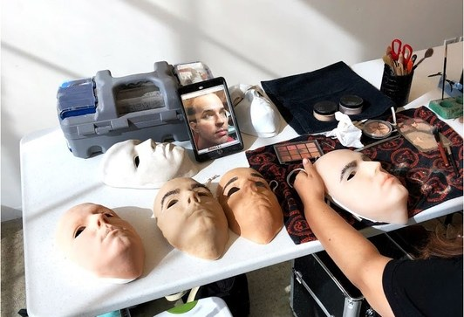
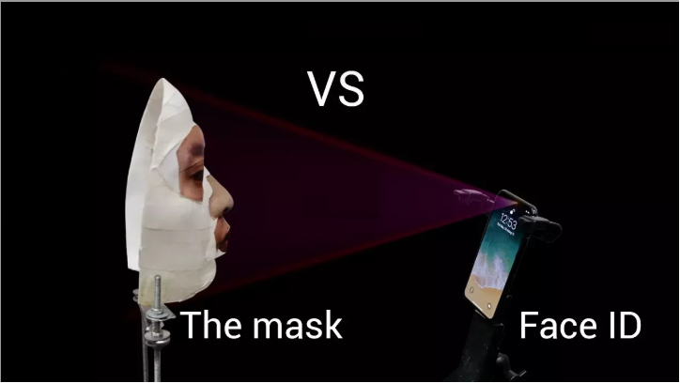
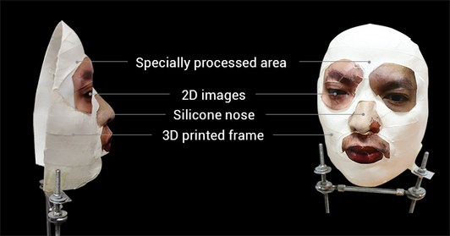
Biometric authentication
From: https://www.wired.com/story/hackers-say-broke-face-id-security/

Slide 8
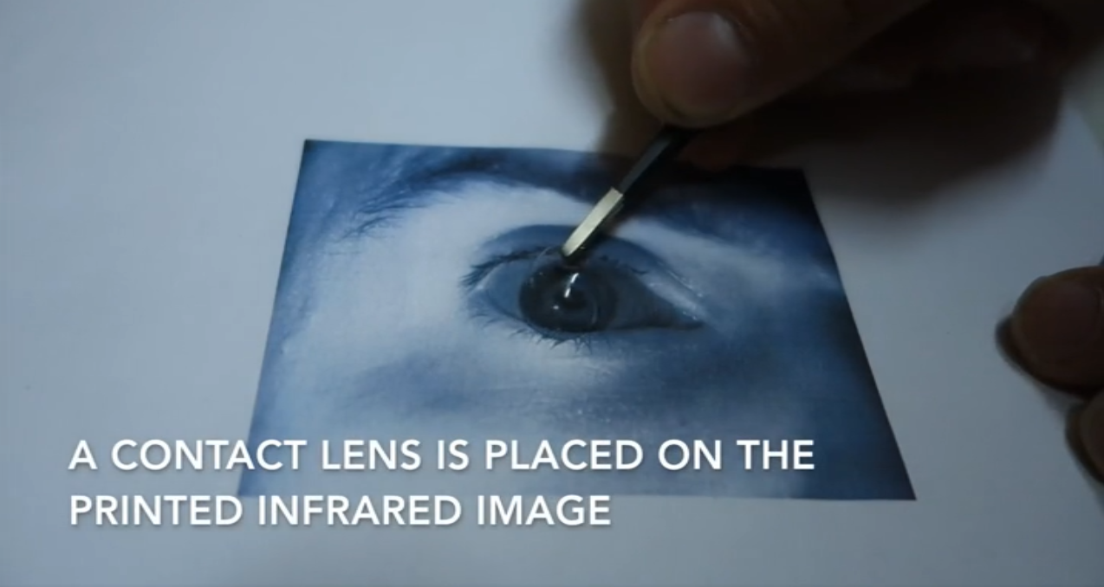
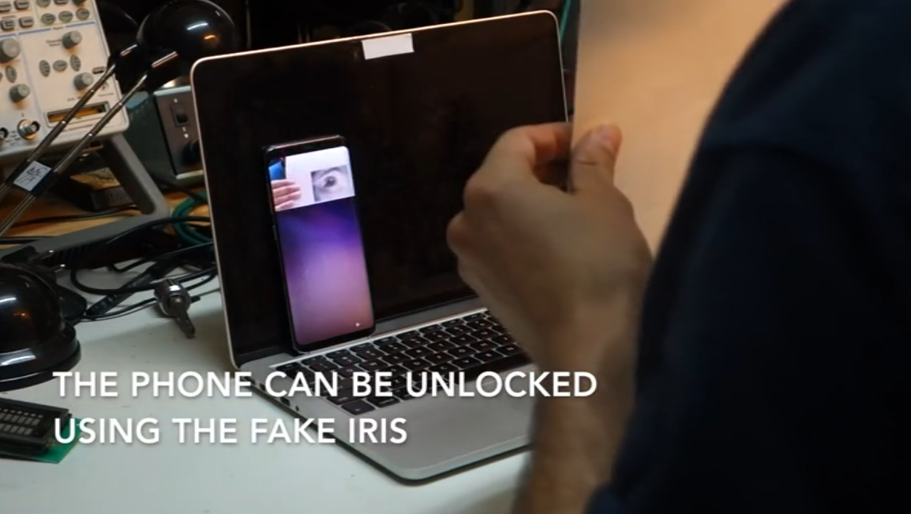
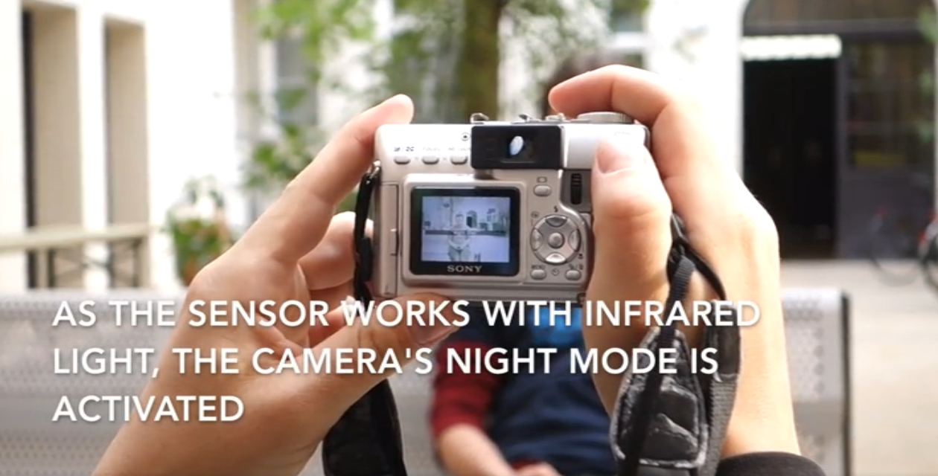
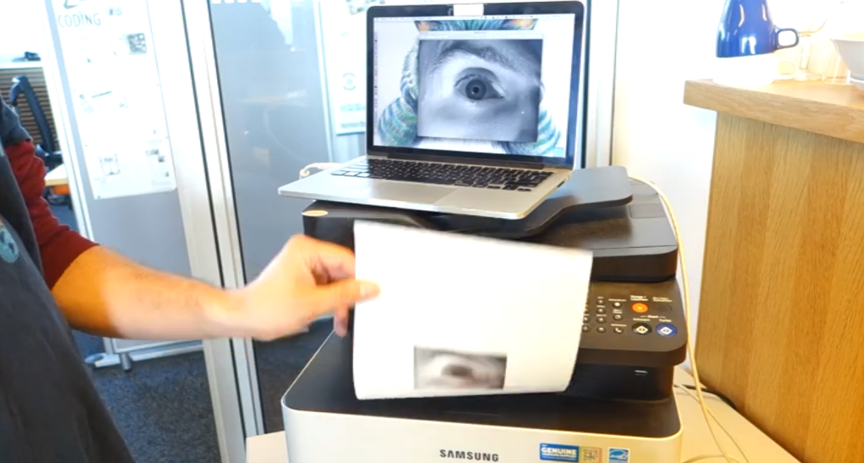
Biometric authentication
From: https://media.ccc.de/v/biometrie-s8-iris-en#t=77

Slide 9
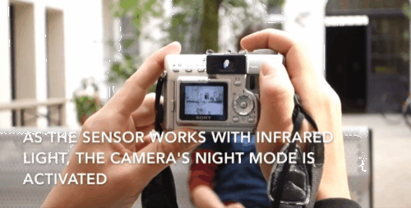
Biometric authentication
A new biometric is needed!

Slide 10



If ideal …

Slide 11
If ideal …
User-friendly
Hard to divulge
Hard to reproduce

Slide 12
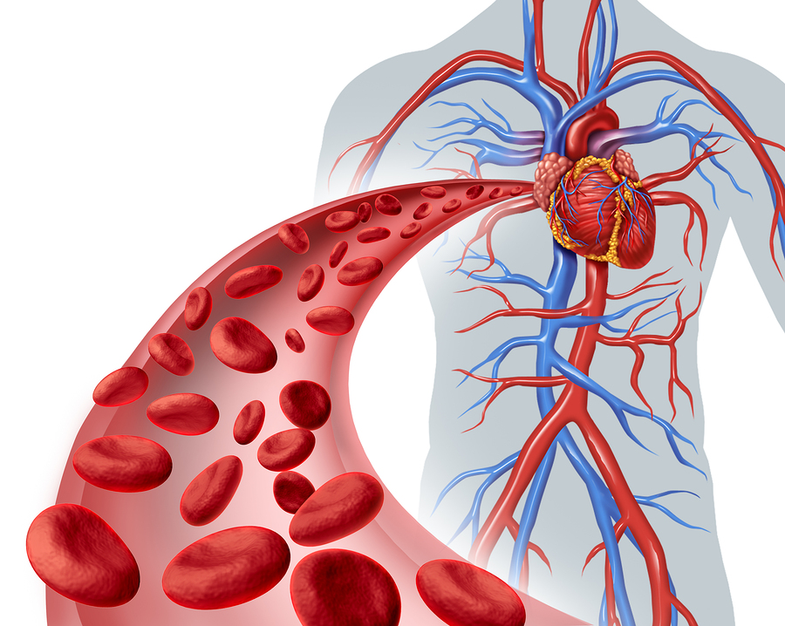
Blood Vessel
The blood vessels are the most critical part of the human circulatory system

Slide 13

Blood Vessel
1. Unique
3. Invisible
2. Ubiquitous

Slide 14
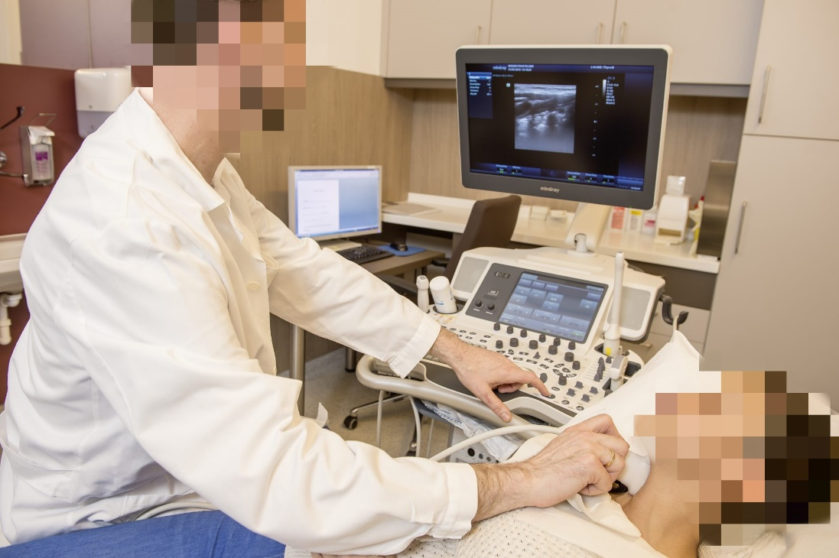
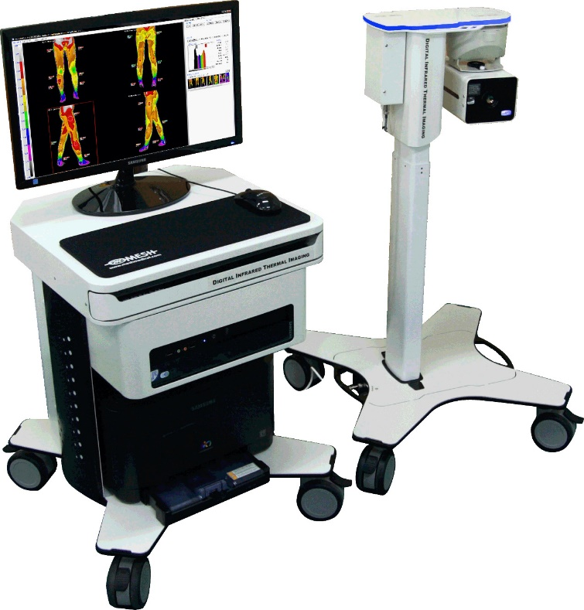
Conventional techniques
Ultrasound Sensing
Optical Sensing
Doppler
Infrared

Slide 15
Conventional techniques
Inferior resolution
Low resolution

Slide 16
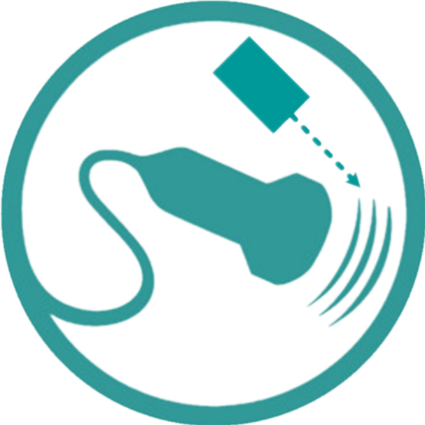
Our System: PAvessel
3D Vessel Structure
+
Photoacoustics (PA) Effect

Slide 17
Our System: PAvessel
3D Vessel Structure
+
Photoacoustics (PA) Effect

Slide 18

Our System: PAvessel
3D Vessel Structure
+
Photoacoustics (PA) Effect
1. Image/model attack
3. Hard to be duplicated
2. Hard to be spoofed

Slide 19
Our System: PAvessel
3D Vessel Structure
+
Photoacoustics (PA) Effect

Slide 20
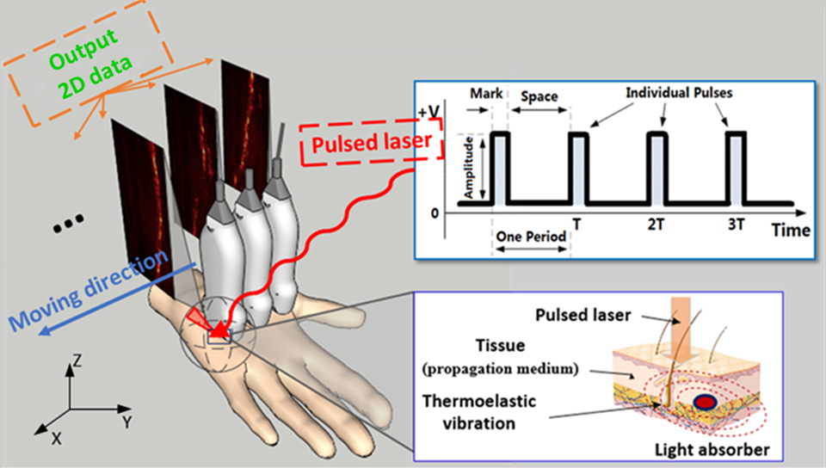
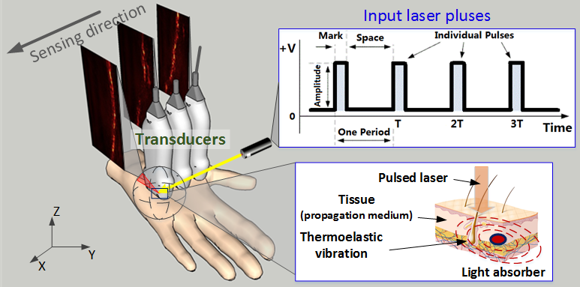
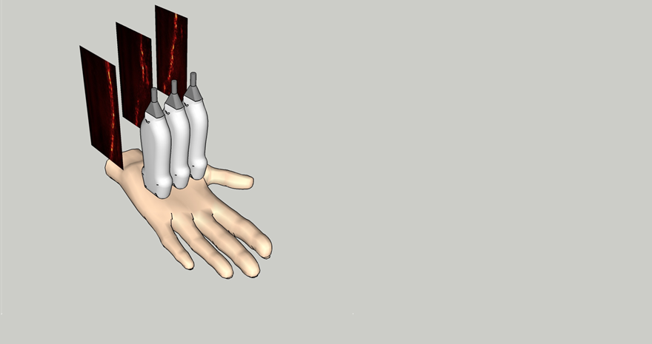
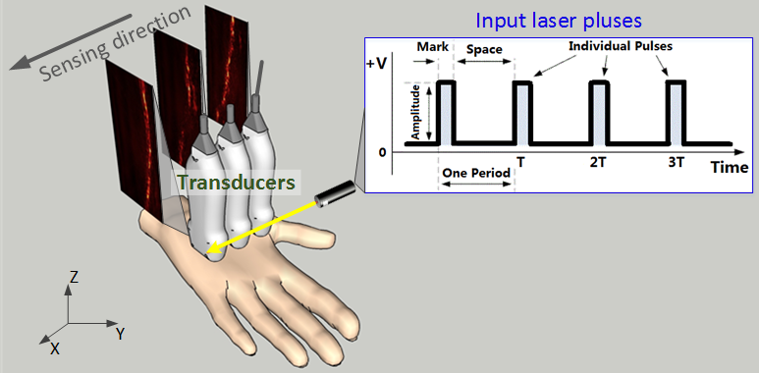
PA effect

Slide 21
Scattering coefficient is much smaller

Slide 22
Signal is generated from deep tissue

Slide 23
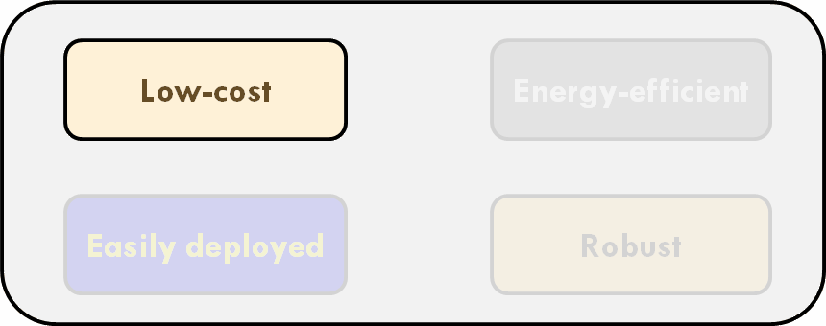
Challenge!

Slide 24
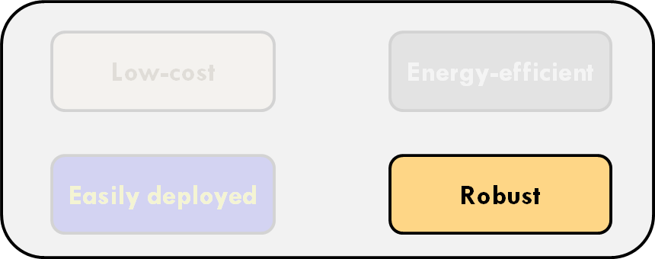
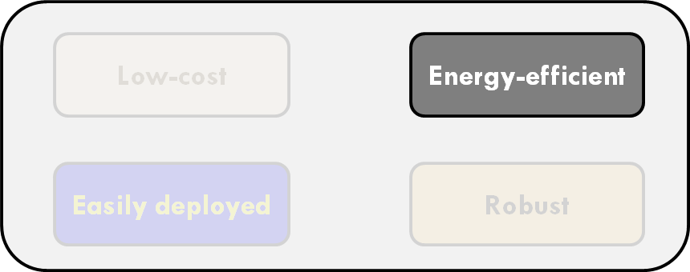
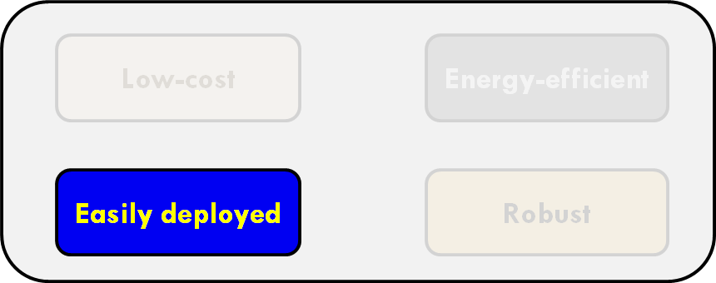
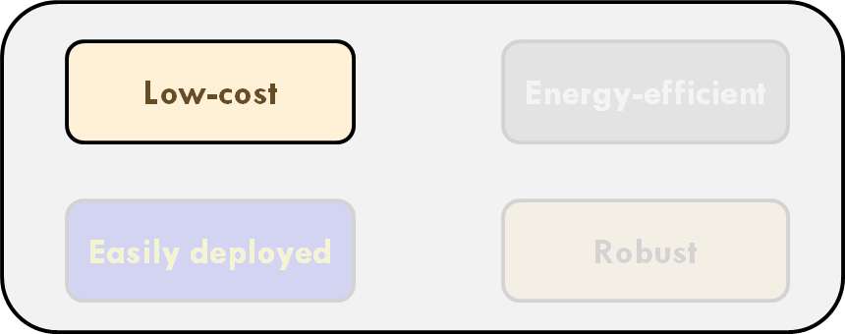

Slide 25
How to achieve these?

Slide 26
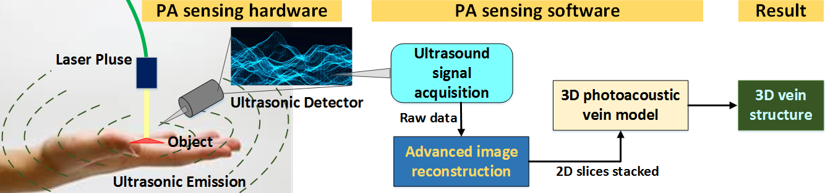
System overview

Slide 27
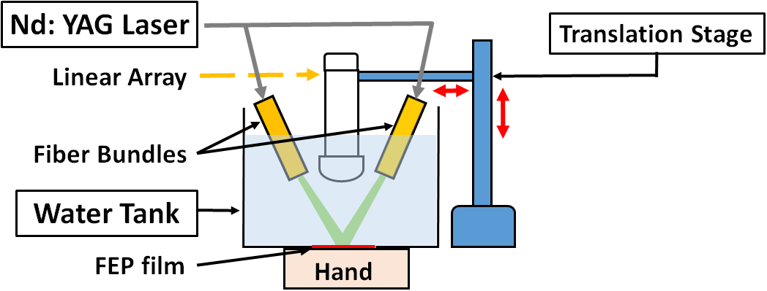
PA sensing hardware
Low-cost and efficient PA sensing

Slide 28
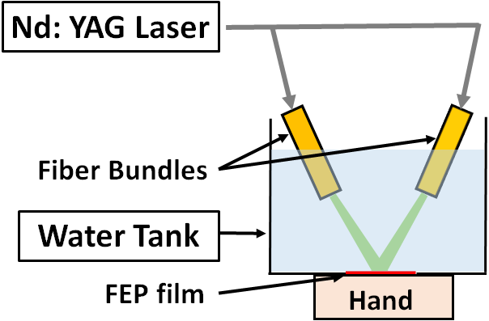
PA sensing hardware
Opportunistic optimization sensing

Slide 29
PA sensing hardware
One transducer

Slide 30
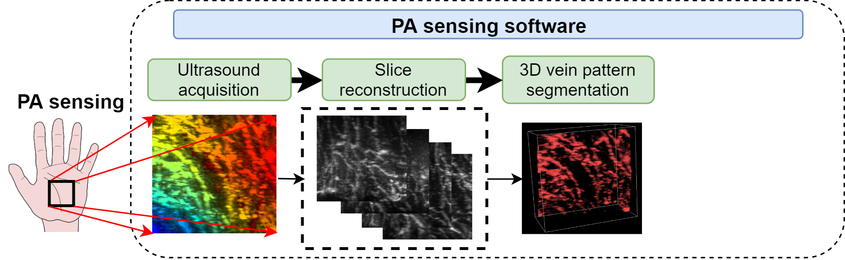
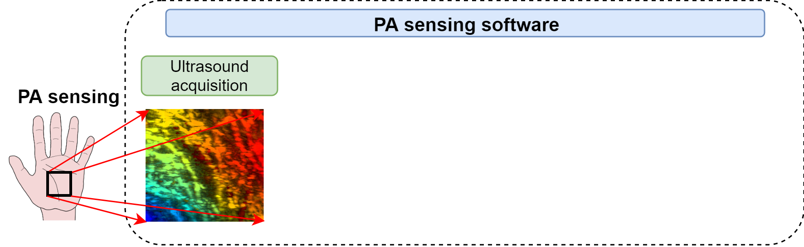
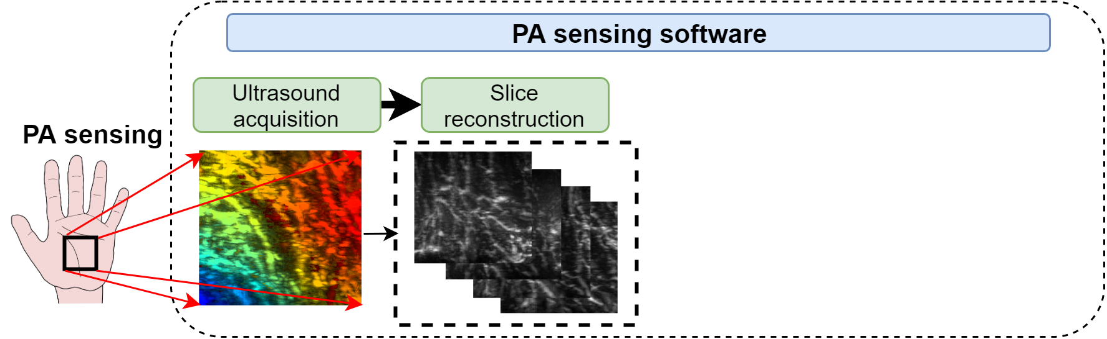
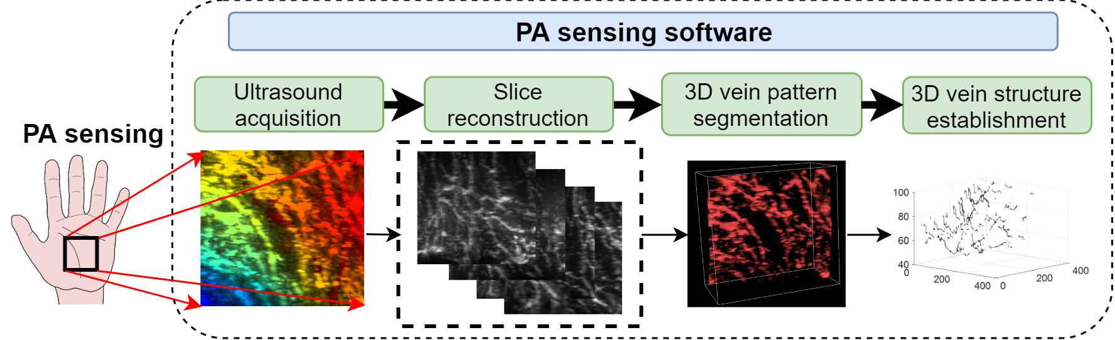
PA sensing software

Slide 31
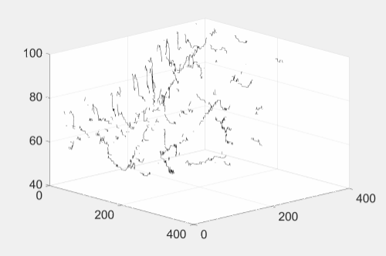
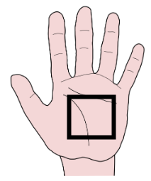
PA sensing software

Slide 32
How do they perform?

Slide 33
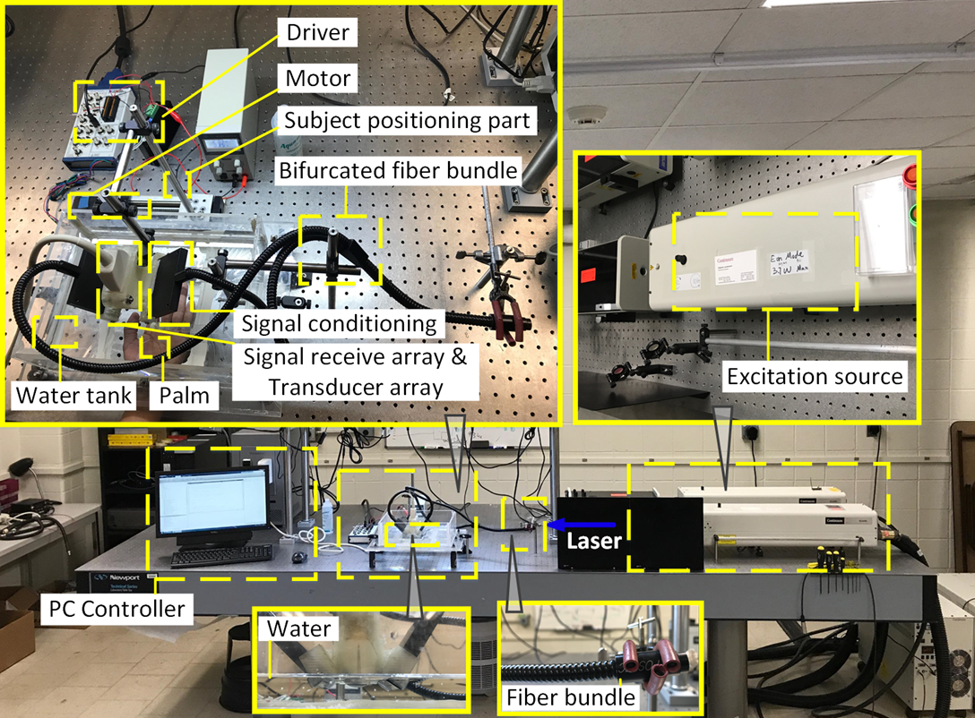
Experimental setup

Slide 34
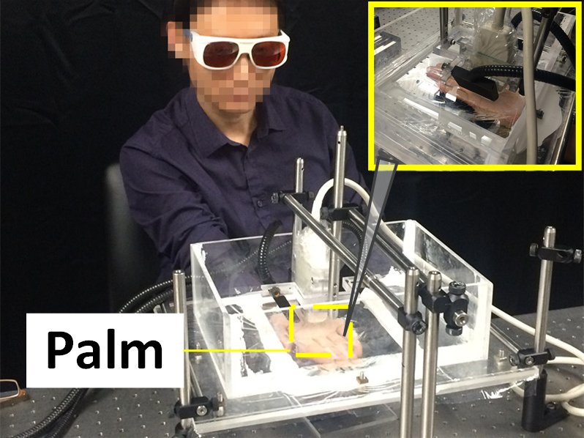
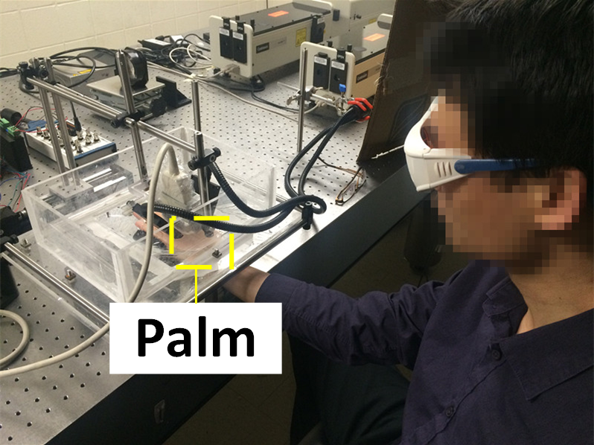
Procedure
Front view
Side view

Slide 35
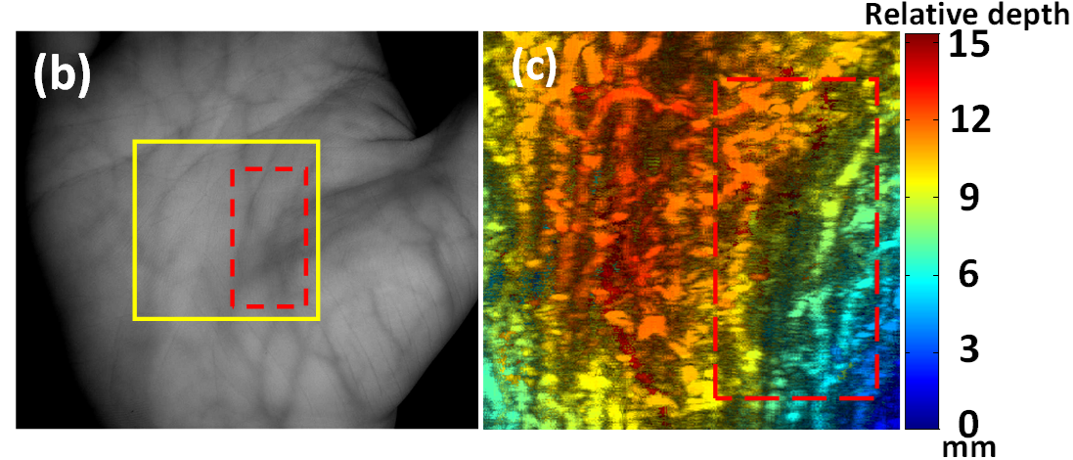
Result - Comparison of PA and IR
Is PA really good?
IR imaging
PA imaging

Slide 36
Result - Comparison of PA and IR
+35%
+52%
IR imaging
PA imaging

Slide 37
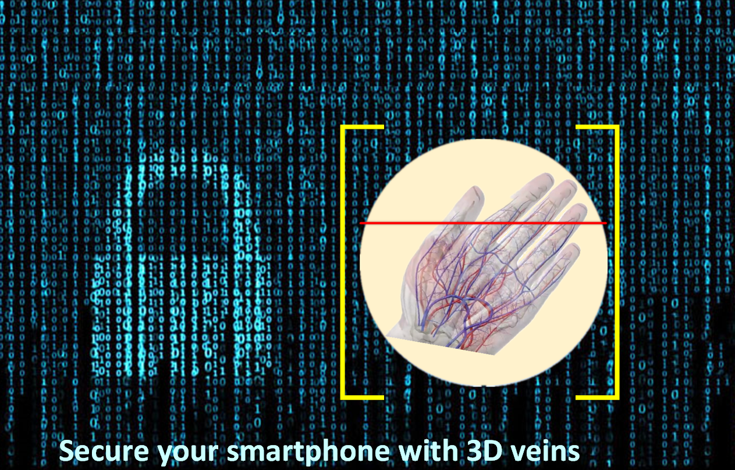
A case study

Slide 38
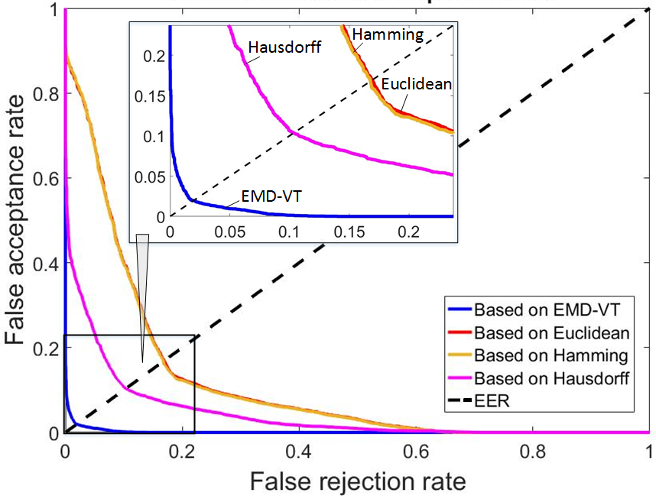
Biometric performance
EER
1.9%

Slide 39
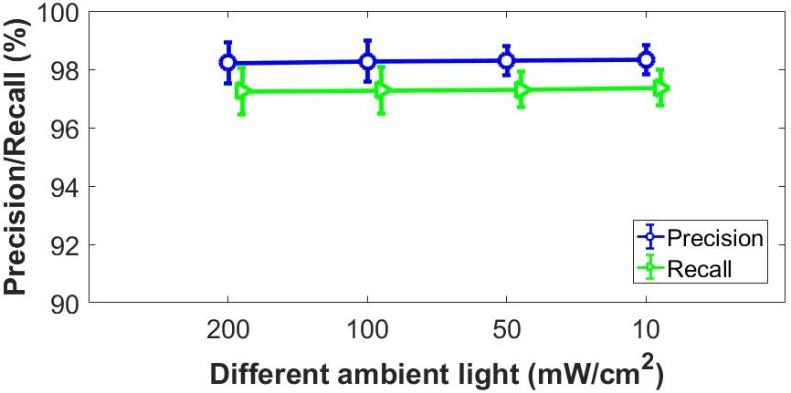
Robustness to ambient light

Slide 40
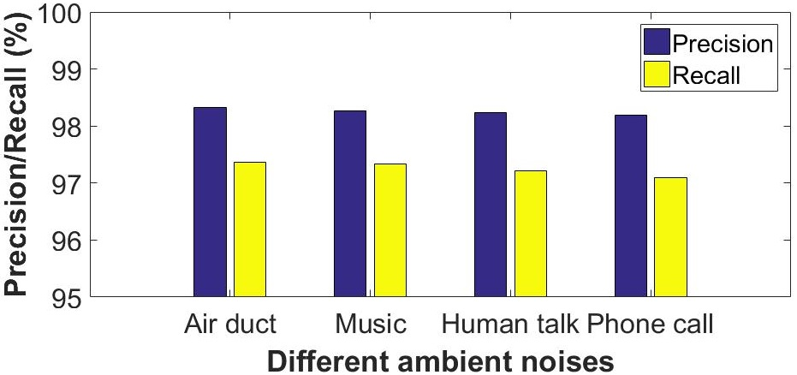
Robustness to ambient noises

Slide 41
Finishing up

Slide 42
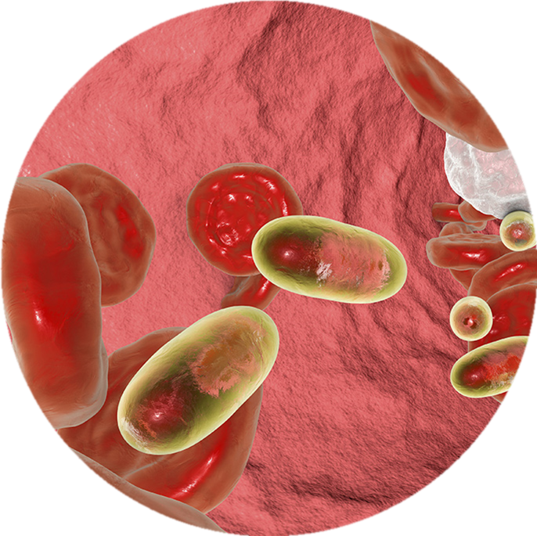
PA sensing optimization
Commodity Exploration

Slide 43
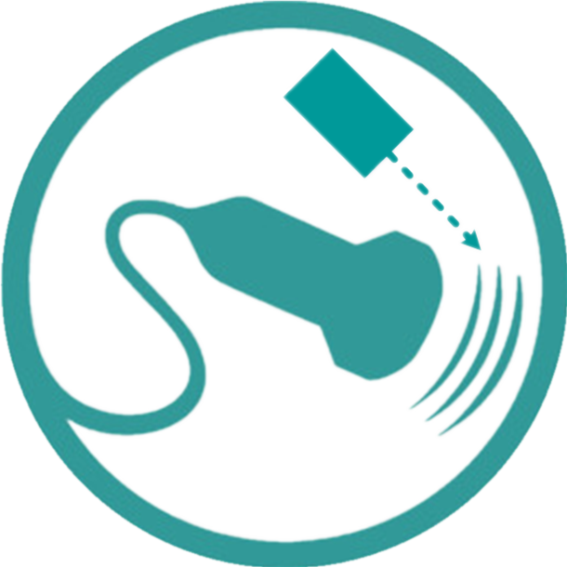
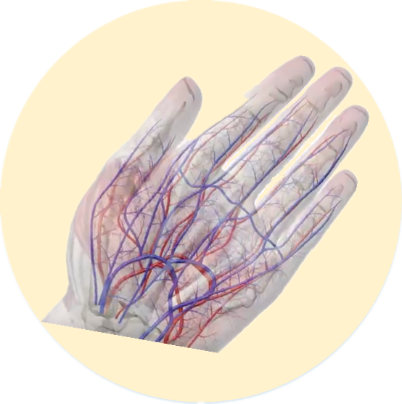
Conclusion

Slide 44
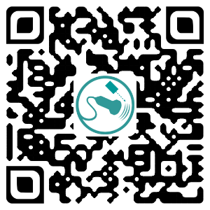

Thank you!

Slide 45
Back up slices

Slide 46
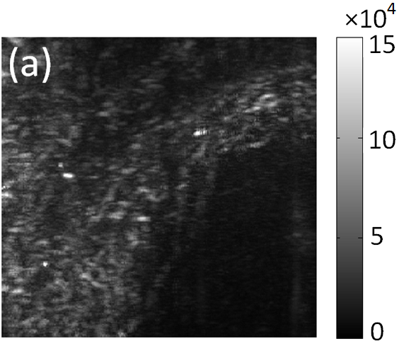

Result – Excitation source effect (1/3)
32 mJ/cm²

Slide 47
Result – Excitation source effect (1/3)
Within the safety limit < 100 mJ/cm²
800 mJ/Pulse

Slide 48

Result – Excitation source effect (2/3)
26 mJ/cm²

Slide 49

Result – Excitation source effect (3/3)
19 mJ/cm²

Slide 50

Vessel mapping: M to N
Challenge!

Slide 51
Vessel mapping: M to N

Slide 52

The EMD-VT matching

